Slide 1

BHILAI INSTITUTE OF TECHNOLOGY, RAIPUR
PROJECT PHASE -1 PRESENTATION
Securing the Sensitive Data at Transaction using the AES & RSA Algorithms
Faculty Incharge-
Prof. Lalita Panika
Assistant Professor
CSE Department.
Presented by 7th semester students-
Harsh Chandrakar (309302220027)
J Kirti Rao (309302220040)
Varun Maharana (309302220094)
Simran Dey Biswas (309302220098)

Slide 2
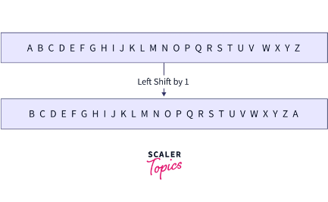
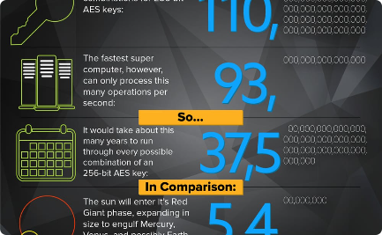
Introduction
Cryptography
The art and science of concealing the messages to introduce secrecy in information security is recognized as cryptography. The process of disguising a message in such a way as to hide its substance is encryption. An encrypted message is ciphertext.
Cloud Computing
Simply put, cloud computing is the delivery of computing services—including servers, storage, databases, networking, software, analytics, and intelligence—over the Internet.

Slide 3
Introduction
Types of Cryptographic Algorithms
Symmetric Key Algorithms | These algorithms use the same key for encryption and decryption. Examples include AES, DES, and 3DES.
Asymmetric Key Algorithms | These algorithms use a pair of keys, a public key and a private key, for encryption and decryption. Examples include RSA and Elliptic Curve Cryptography.
Hashing Algorithm | These algorithms are designed to create a digital fingerprint of data. They are often used for data integrity and authentication. Examples include SHA-256 and MD5.

Slide 4
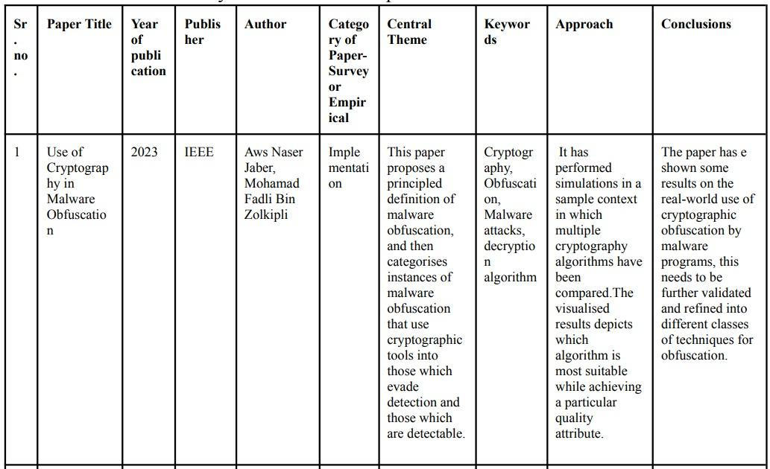
Literature Review

Slide 5
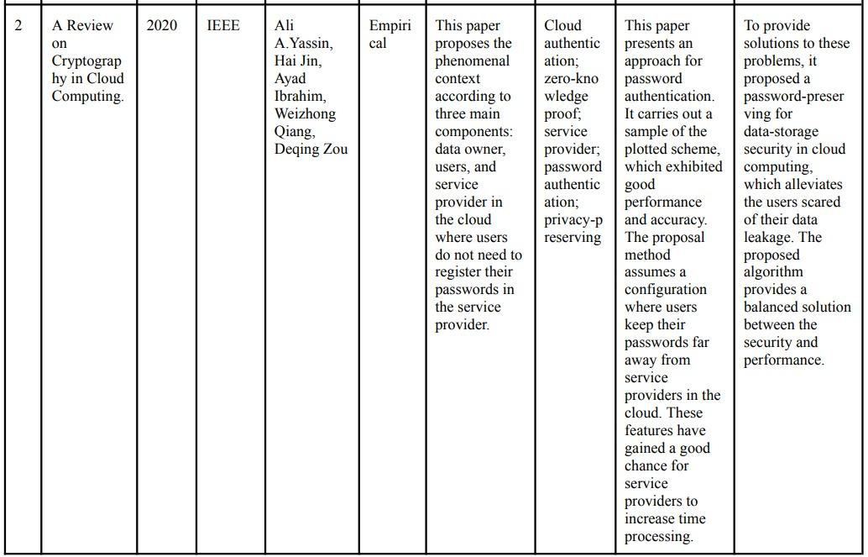
Literature Review

Slide 6
Research Gap
One of the prominent cryptographic techniques which have been researched in this paper to provide privacy and fine-grained access control in cloud computing is Hashing.
This paper gives a brief understanding about the encryption of data before storing it in the Cloud. This is the major gap showed between both the above presented papers and our objective.
The paper has explored more on ciphertext policy in different aspects such as hidden policy, proxy re-encryption, revocation mechanism, and hierarchical attribute based encryption.
The paper has analysed the top security threats and their existing solutions and also investigates the challenges/obstacles in implementing threat remediation.

Slide 7
Expected Outcome
Confidentiality
Integrity
Accuracy
Required to safeguard the privacy of those whose private information is kept. The data should be itself in a secure form while travelling over the insecure internet.
Security environment refers to the accuracy of information management and associated information. It indicates that the data is transported and handled in controlled situations and remains unchanged even after it has been processed.
The accuracy of the information's origin or destination, as well as the identities of the transmitter and receiver, is ensured. Only a specific key exchange used by the sender to confirm their identity can ensure authenticity

Slide 8
Proposed Methodology
The Cloud itself has security measures and protocols that provides security from unauthorized access to the underlying services that it offers. For example, Identity and Access Management, Public and Private IP Addresses, VPNs, etc.
But even though the CSP (e.g. AWS) offers encryption of data while at rest and at transit, it still has a risk of exposing the data that can be sensitive at the client side.
So to counter this approach, what can be done is when the frontend takes in the data that is entered by the client, it can immediately be encrypted at the client side itself, creating a safer version of the data when being sent over the insecure internet to reach the server and then get encrypted.

Slide 9
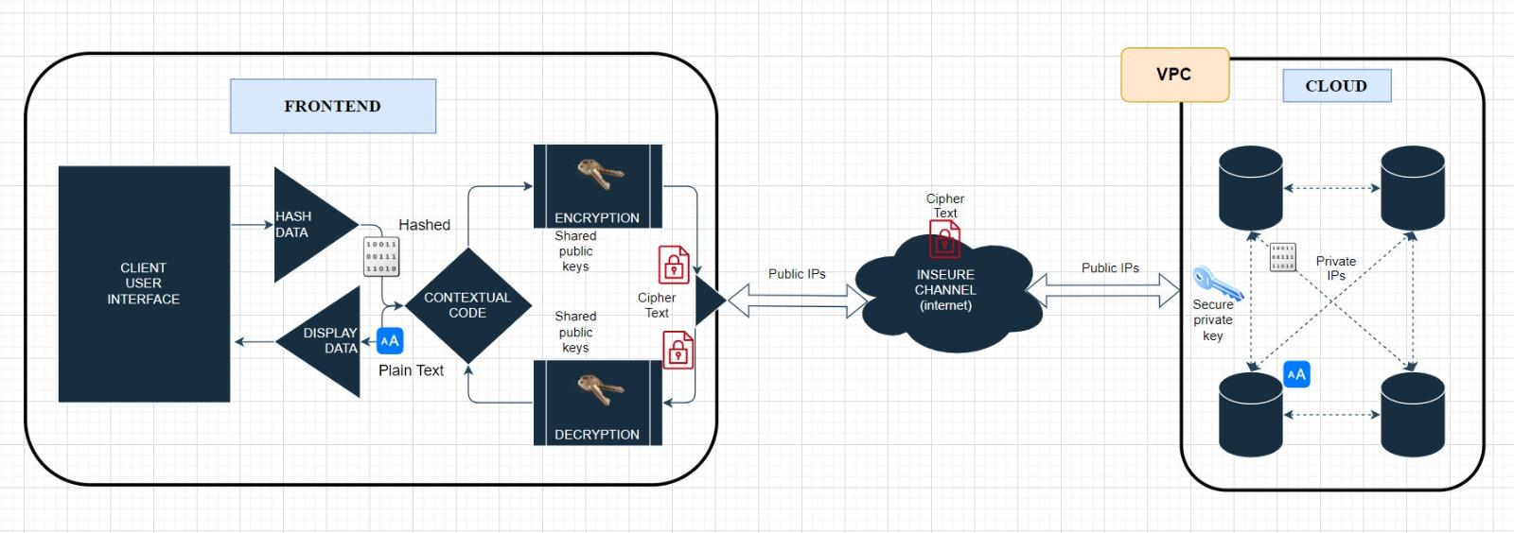
Conceptualised Flow Diagram

Slide 10
Proposed Methodology
So our proposed methodology takes an inspiration from how cloud security architecture works (i.e. the concept of public IP and private IP address to talk over the internet and intranet respectively) and the hybrid category of algorithm (i.e. a combination of both asymmetric and hashing algorithms)
Trying to implement the idea similar to the concept of public/private IP, we use the combination of public keys and private keys both in the client side and server side, to create a secure encrypt-decrypt sequence while sending/receiving data from and to any side of the communication.
Next, by implementing the hashing algorithms, the data can be converted in a more unrecognizable version, which then can be again encrypted using using the previously mentioned step.
By executing the above steps we can encrypt the data into its extra protected version, that can be considered comparatively more secure and less recognizable while travelling from the client side to the cloud or vice versa.

Slide 11
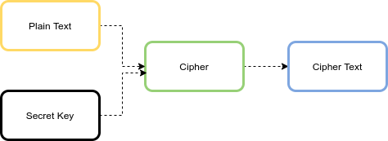
Last Progress
AES - Advanced Encryption Standard
The AES algorithm is an iterative, symmetric-key block cipher that supports cryptographic keys (secret keys) of 128, 192, and 256 bits to encrypt and decrypt data in blocks of 128 bits. The below figure shows the high-level AES algorithm:

Slide 12
AES Algorithm-
AES algorithm is the method of lesser time complexity and due to its flexible and scalable behaviour it is easily implemented.
AES algorithm protects data with its high security level and can counterattack against a variety of attacks.
AES algorithm requires less storage space while providing a higher performance without any major limitations.

Slide 13
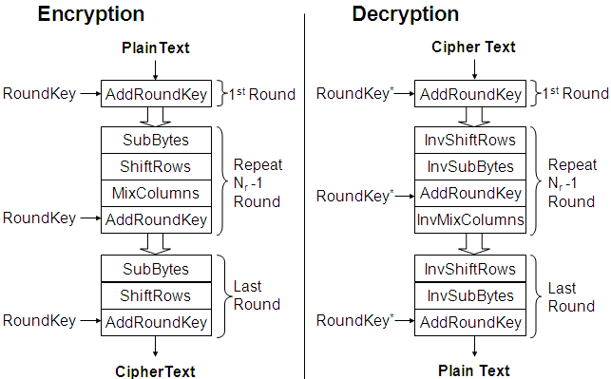
AES Encryption & Decryption Flowchart

Slide 14
Recent Progress
AES Algorithm: Implementation Limitations
It is symmetric algorithms, therefore implementing this for data transaction from cloud can expose the key while sharing it.
Implementing such an algorithm using a robust programming language ike JAVA was easier as it already had existing official packages that supports the implementation.
But while implementing it on the client-side using a language like JavaScript might not provide such packages rather we have to use less reliables packages available in the open source domain.

Slide 15
Recent Progress
RSA Algorithm: Implementation Limitations
Implementing such an algorithm using a robust programming language like JAVA was easier as it already had existing official packages that supports the implementation.
But while implementing it on the client-side using a language like JavaScript might not provide such packages rather we have to use less reliables packages available in the open source domain.

Slide 16
Recent Progress
RSA -
The RSA algorithm is a public-key signature algorithm developed by Ron Rivest, Adi Shamir, and Leonard Adleman. Their paper was first published in 1977, and the algorithm uses logarithmic functions to keep the working complex enough to withstand brute force and streamlined enough to be fast post-deployment.
There are two broad components when it comes to RSA cryptography, they are:
Key Generation: Generating the keys to be used for encrypting and decrypting the data to be exchanged.
Encryption/Decryption Function: The steps that need to be run when scrambling and recovering the data.

Slide 17
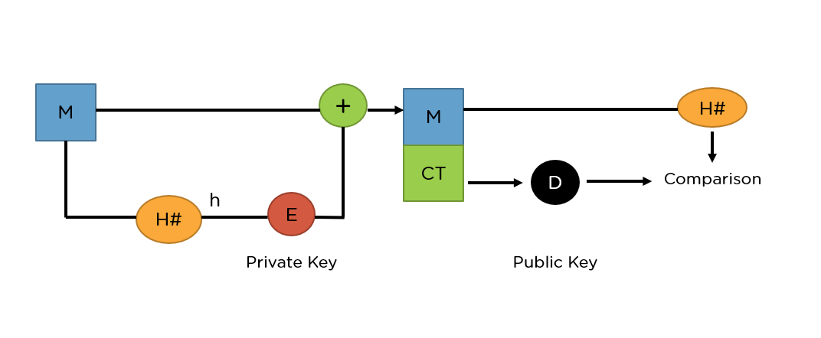
Basic RSA Flowchart-
RSA can also encrypt and decrypt general information to securely exchange data along with handling digital signature verification. The image above shows the entire procedure of the RSA algorithm.

Slide 18
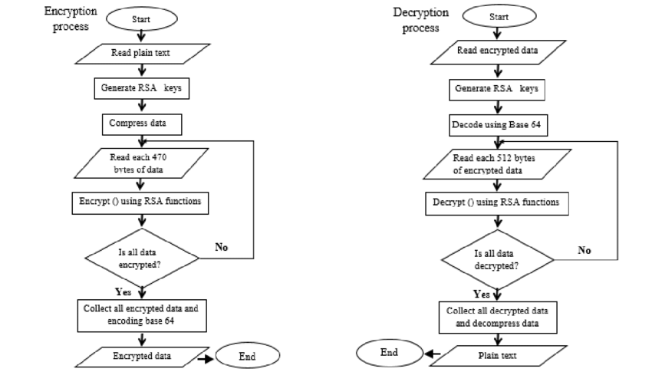
RSA Encryption & Decryption Flowchart

Slide 19
Recent Progress
RSA Algorithm: Implementation
We tried to implement the RSA Algorithm which uses both public key and private keys for both encryption and decryption and observe the merits and limitations
Language Used: JAVA
IDE: IntelliJ IDEA
Algorithm: RSA

Slide 20
RSA Algorithm: Implementation
Code used to Generate Public and Private Key:
System.out.println("-------GENRATE PUBLIC and PRIVATE KEY-------------");
KeyPairGenerator keyPairGenerator = KeyPairGenerator.getInstance("RSA");
keyPairGenerator.initialize(2048); //1024 used for normal securities
KeyPair keyPair = keyPairGenerator.generateKeyPair();
PublicKey publicKey = keyPair.getPublic();
PrivateKey privateKey = keyPair.getPrivate();
System.out.println("Public Key - " + publicKey);
System.out.println("Private Key - " + privateKey);

Slide 21
RSA Algorithm: Implementation
Code used to pull values from the keys generated:
//Pulling out parameters which makes up Key
System.out.println("\n------- PULLING OUT PARAMETERS WHICH MAKES KEYPAIR----------\n");
KeyFactory keyFactory = KeyFactory.getInstance("RSA");
RSAPublicKeySpec rsaPubKeySpec = keyFactory.getKeySpec(publicKey, RSAPublicKeySpec.class);
RSAPrivateKeySpec rsaPrivKeySpec = keyFactory.getKeySpec(privateKey, RSAPrivateKeySpec.class);
System.out.println("PubKey Modulus : " + rsaPubKeySpec.getModulus());
System.out.println("PubKey Exponent : " + rsaPubKeySpec.getPublicExponent());
System.out.println("PrivKey Modulus : " + rsaPrivKeySpec.getModulus());
System.out.println("PrivKey Exponent : " + rsaPrivKeySpec.getPrivateExponent());

Slide 22
RSA Algorithm: Implementation
Method used for Encryption:
private byte[] encryptData(String data) throws IOException {
System.out.println("\n----------------ENCRYPTION STARTED------------");
System.out.println("Data Before Encryption :" + data);
byte[] dataToEncrypt = data.getBytes();
byte[] encryptedData = null;
try {
PublicKey pubKey = readPublicKeyFromFile(PUBLIC_KEY_FILE);
Cipher cipher = Cipher.getInstance("RSA");
cipher.init(Cipher.ENCRYPT_MODE, pubKey);
encryptedData = cipher.doFinal(dataToEncrypt);
System.out.println("Encryted Data: " + encryptedData);
} catch (Exception e) {
e.printStackTrace();
}
System.out.println("----------------ENCRYPTION COMPLETED------------");
return encryptedData;
}

Slide 23
RSA Algorithm: Implementation
Method used for Decryption:
private void decryptData(byte[] data) throws IOException {
System.out.println("\n----------------DECRYPTION STARTED------------");
byte[] descryptedData = null;
try {
PrivateKey privateKey = readPrivateKeyFromFile(PRIVATE_KEY_FILE);
Cipher cipher = Cipher.getInstance("RSA");
cipher.init(Cipher.DECRYPT_MODE, privateKey);
descryptedData = cipher.doFinal(data);
System.out.println("Decrypted Data: " + new String(descryptedData));
} catch (Exception e) {
e.printStackTrace();
}
System.out.println("----------------DECRYPTION COMPLETED------------");
}

Slide 24
Recent Progress
RSA Algorithm: Output
Original: This is a classified information!
Encrypted: [B@2d6d8735
Decrypted: This is a classified information!

Slide 25
Next Steps
The next step would be implementing the RSA algorithm using a programming language like JAVA and the client side language like JavaScript and observing the merits and limitations just like the AES Algorithm.
Also, to find, read and review more papers related to the subject and to prepare the draft paper accordingly.

Slide 26
References
[1] Muller, M. A., Grundy, I., & Morsy, J. (2014). An analysis of the cloud computing security problem. Int. Surg, 47(3), 288-290.
[2] Abdulsalam, Y.S.A.; Hedabou, M. Security and Privacy in Cloud Computing: Technical Review. Future Internet 2022, 14, 11. https:// doi.org/10.3390/fi14010011
[3] Olowu, M., Yinka-Banjo, C., Misra, S., & Florez, H. (2019). A Secured Private-Cloud Computing System. Applied Informatics, 373–384. https://doi.org/10.1007/978-3-030-32475-9_27
[4] Jackson, K. R., Ramakrishnan, L., Muriki, K., Canon, S., Cholia, S., Shalf, J., ... & Wright, N. J. (2010, November). Performance analysis of high performance computing applications on the amazon web services cloud. In 2010 IEEE second international conference on cloud computing technology and science (pp. 159-168). IEEE.
[5] Khan, A. R., & Alnwihel, L. K. (2023). A Brief Review on Cloud Computing Authentication Frameworks. Engineering, Technology & Applied Science Research, 13(1), 9997-10004.
[6] Verma, O. P., Agarwal, R., Dafouti, D., & Tyagi, S. (2011, April). Notice of Violation of IEEE Publication Principles: Performance analysis of data encryption algorithms. In 2011 3rd International Conference on Electronics Computer Technology (Vol. 5, pp. 399-403). IEEE.
[7] Asghar, H. J., Zhao, B. Z. H., Ikram, M., Nguyen, G., Kaafar, D., Lamont, S., & Coscia, D. (2022). SoK: Use of Cryptography in Malware Obfuscation. arXiv preprint arXiv:2212.04008.
[8] Jan, M., Shahzad, Q., & Afsar, S. (2022). Securing the Cloud Storage by Using Different Algorithms of Cryptography. International Journal of Scientific Research in Computer Science Engineering and Information Technology, 38-45.

Slide 27
Thankyou!

